Slide 1
Kelly, College Enquiry Chatbot
Using Natural Language Processing and Machine Learning
Project Guide: Prof. Shubhada Deshmukh

Slide 2
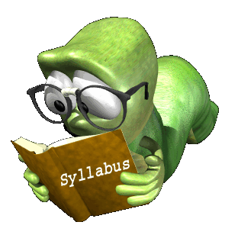
Introduction to the Problem
A domain specific knowledge system to provide answers to FAQs about various courses under CSE - VIT
Students Prefer Personal Interaction over hours of searching and browsing.
The main goal of such a system is to conveniently retrieve information without having to look for information under a hierarchy of archives on the web.

Slide 3

Domain of Interest:
The Chatbot will be a general Enquiry Chatbot aimed at answering questions based on the various Academic Details about Courses taught in a CSE/IT VIT, Pune.

Slide 4

Solution
Space
Creating a Domain Specific Chatbot/Virtual Assistant that will address various commonly asked questions of the student and make the required information available almost instantly.

Slide 5
The Initial Approach
The Initial approach involved the use of a NLU platform : API.AI
The Platform involved concepts such as Contexts, Entities, Intents,etc.
This Approach required us to model the system, rather than develop it.
Considering the shallow learning experience in this way of implementation, this approach was scrapped.
Approaches with programming at its core, and that were algorithmic in nature were further considered.

Slide 6
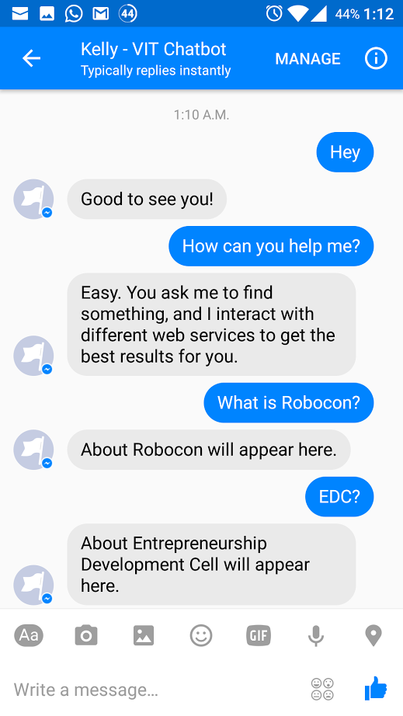
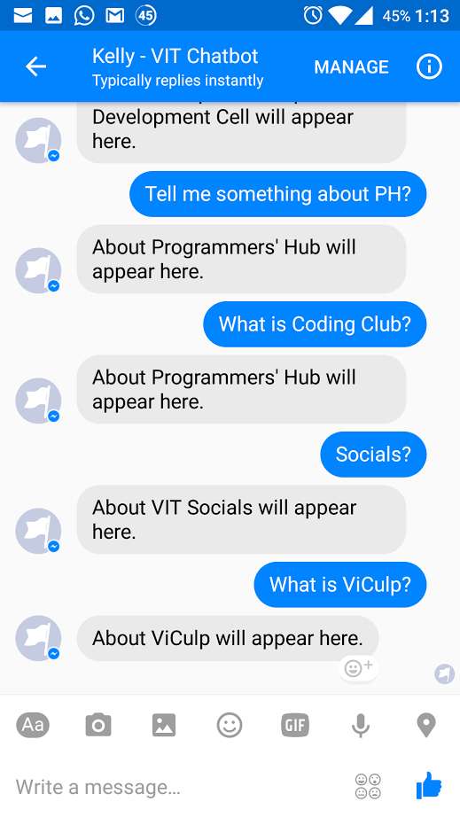
Screenshots

Slide 7
The Next Approach
Approach had to be Implementation oriented rather than Design oriented.
As most experts suggest the Following Technology Stack :
Python
NLTK Lib.
AIML
Kivy GUI

Slide 8
User Input
Greetings or FAQ queries in Natural Language (English).
The FAQ queries are restricted to be related to Computer Department VIT, Pune Courses (The current database only handles few courses, although it can be easily expanded to support on any course).
For instance, the queries can be regarding Venue, Instructor Name, etc. of a particular course

Slide 9
System Outputs
System responses can be majorly categorized into three types:
Niceties: Polite social responses with respect to greetings from the user.
Domain Specific responses: Responses closely satisfying the user queries.
Apologetic responses: Responses meant to convey inability to retrieve requested information.

Slide 10
Dual Phase Operation
Following are the two phases in execution of our Enquiry System:
Training Phase
Pattern Matching Phase

Slide 11
Training Phase
We have used natural language processing library NLTK to process raw queries (training set) and convert them into a set of synonymous words (reduced query). This in short describes the context/concept of the query. Of course the golden rule applies, more data, better results.
The expected answer to such reduced query is known and we use this knowledge to generate aiml/xml files for pattern matching purposes.

Slide 12
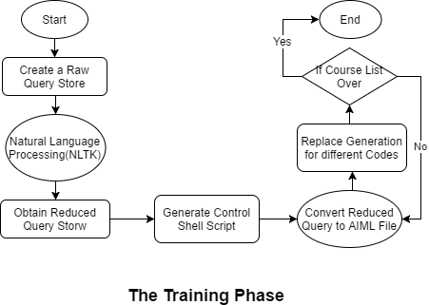

Slide 13
Pattern Matching Phase
User’s input is again broken down to a reduced query using NLP and we use AIML files generated from phase 1 to find the closest possible pattern existing in our database for which the answer is known.
If such pattern exists we output the information retrieved from the database or otherwise we just try to stall the conversation to keep the user interested or apologize for the inability to answer.

Slide 14
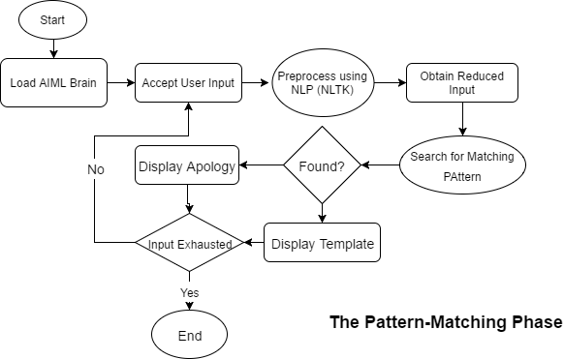

Slide 15
NLTK
NLTK is a platform to work with human language data.
It provides easy-to-use interfaces to over 50 corpora and lexical resources such as WordNet
Suite of text processing libraries for classification, tokenization, stemming, tagging, parsing, and semantic reasoning, wrappers for industrial-strength NLP libraries
We have used natural language processing library NLTK to process raw queries (training set) and convert them into a set of synonymous words (reduced query). This in short describes the context/concept of the query.

Slide 16
Tokenizing
Stop words removal
Stemming
PunktSentence tokenizer
Chunking
Chinking
Lemmatizing
Similarity
Phases of Preprocessing

Slide 17
Tokenization : Input Words
Chopping up char strings into pieces called tokens.
Using word_tokenize(), we find out words from a sentence using space as delimiter.
from nltk.tokenize import sent_tokenize, word_tokenize EXAMPLE_TEXT = "Hello Mr. Smith, how are you doing today? The weather is great, and Python is awesome. The sky is pinkish-blue. You shouldn't eat cardboard." print(word_tokenize(EXAMPLE_TEXT))
Now our output is: ['Hello', 'Mr.', 'Smith', ',', 'how', 'are', 'you', 'doing', 'today', '?', 'The', 'weather', 'is', 'great', ',', 'and', 'Python', 'is', 'awesome', '.', 'The', 'sky', 'is', 'pinkish-blue', '.', 'You', 'should', "n't", 'eat', 'cardboard', '.']

Slide 18
Stop Words Removal
After this process, words like – is, are, and, etc which help to connect important words are removed
example_sent = "This is a sample sentence, showing off the stop words filtration." stop_words = set(stopwords.words('english')) word_tokens = word_tokenize(example_sent) filtered_sentence = [w for w in word_tokens if not w in stop_words] filtered_sentence = [] for w in word_tokens: if w not in stop_words: filtered_sentence.append(w) print(word_tokens) print(filtered_sentence)
Output here:
['This', 'is', 'a', 'sample', 'sentence', ',', 'showing', 'off', 'the', 'stop', 'words', 'filtration', '.']
['This', 'sample', 'sentence', ',', 'showing', 'stop', 'words', 'filtration', '.']

Slide 19
Stemming
The idea of stemming is a sort of normalizing method. Many variations of words carry the same meaning, other than when tense is involved.
The reason why we stem is to shorten the lookup, and normalize sentences.
Stemming will detect the root of every word.
Porter Stemmer algorithm is used here
from nltk.stem import PorterStemmer from nltk.tokenize import sent_tokenize, word_tokenize ps = PorterStemmer()
example_words = ["python","pythoner","pythoning","pythoned","pythonly"]
for w in example_words: print(ps.stem(w))
Output:
python python python python pythonli

Slide 20
Part Of Speech Tag (1)
PunktSentenceTokenizer is the abstract class for the default sentence tokenizer, i.e. sent_tokenize(), provided in NLTK
sent_tokenize() uses pre trained model with which we can do:
sent_tokenize (german_text, language='german')
This tokenizer is capable of unsupervised machine learning, so you can actually train it on any body of text that you use.
from nltk.corpus import state_union from nltk.tokenize import PunktSentenceTokenizer
train_text = state_union.raw("2005-GWBush.txt") sample_text = state_union.raw("2006-GWBush.txt")
custom_sent_tokenizer = PunktSentenceTokenizer(train_text)
tokenized = custom_sent_tokenizer.tokenize(sample_text)

Slide 21
Part Of Speech Tag (2)
nltk.pos_tag() is used for list of parts of speech tags
def process_content(): try: for i in tokenized[:5]: words = nltk.word_tokenize(i) tagged = nltk.pos_tag(words) print(tagged) except Exception as e: print(str(e)) process_content()
Output includes:
[('PRESIDENT', 'NNP'), ('GEORGE', 'NNP'), ('W.', 'NNP'), ('BUSH', 'NNP'), ("'S", 'POS'), ('ADDRESS', 'NNP'), ('BEFORE', 'NNP'), ('A', 'NNP'), ('JOINT', 'NNP'), ('SESSION', 'NNP'), ('OF', 'NNP'), ('THE', 'NNP'), ('CONGRESS', 'NNP'), ('ON', 'NNP'), ('THE', 'NNP')]

Slide 22
Chunking
Now that we know the parts of speech, we can do what is called chunking, and group words into hopefully meaningful chunks. One of the main goals of chunking is to group into what are known as "noun phrases." These are phrases of one or more words that contain a noun, maybe some descriptive words, maybe a verb, and maybe something like an adverb. The idea is to group nouns with the words that are in relation to them.
In order to chunk, we combine the part of speech tags with regular expressions.
def process_content(): try: for i in tokenized: words = nltk.word_tokenize(i) tagged = nltk.pos_tag(words) chunkGram = r"""Chunk: {<RB.?>*<VB.?>*<NNP>+<NN>?}""" chunkParser = nltk.RegexpParser(chunkGram) chunked = chunkParser.parse(tagged) chunked.draw() except Exception as e: print(str(e)) process_content()

Slide 23
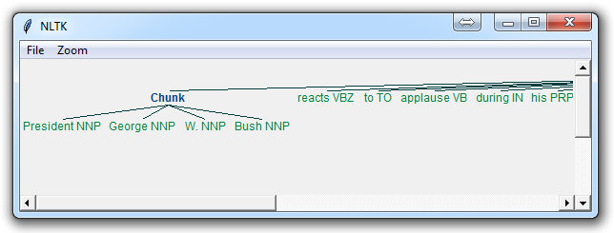
chunkGram = r"""Chunk: {<RB.?>*<VB.?>*<NNP>+<NN>?}"""
This line, broken down:
<RB.?>* = "0 or more of any tense of adverb," followed by:
<VB.?>* = "0 or more of any tense of verb," followed by:
<NNP>+ = "One or more proper nouns," followed by
<NN>? = "zero or one singular noun."

Slide 24
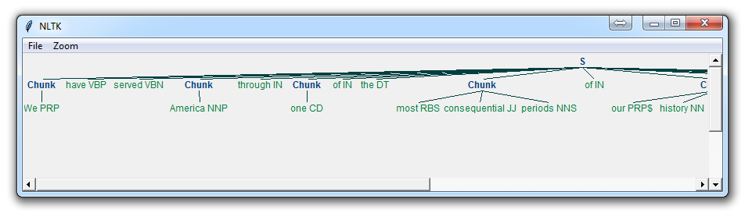
Chinking
chunkGram = r"""Chunk: {<.*>+} }<VB.?|IN|DT|TO>+{"""
Now, the main difference here is:
}<VB.?|IN|DT|TO>+{
This means we're removing from the chink one or more verbs, prepositions, determiners, or the word 'to'.
Chinking is a lot like chunking, it is basically a way for you to remove a chunk from a chunk. The chunk that you remove from your chunk is your chink.
The code is very similar, you just denote the chink, after the chunk, with }{ instead of the chunk's {}.

Slide 25
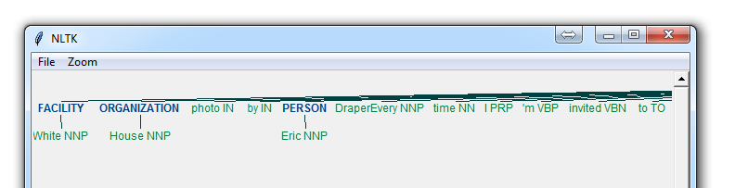
Named Entity Recognition
One of the most major forms of chunking in natural language processing is called "Named Entity Recognition." The idea is to have the machine immediately be able to pull out "entities" like people, places, things, locations, monetary figures, and more.
Here we also use binary variable.
binary = True, this means either something is a named entity, or not.
Entities can be: ORGANIZATION ,PERSON ,LOCATION ,DATE -TIME ,MONEY ,PERCENT ,FACILITY
def process_content(): try: for i in tokenized[5:]: words = nltk.word_tokenize(i) tagged = nltk.pos_tag(words) namedEnt = nltk.ne_chunk(tagged, binary=True) namedEnt.draw() except Exception as e: print(str(e))

Slide 26
Lemmatizing
from nltk.stem import WordNetLemmatizer lemmatizer = WordNetLemmatizer() print(lemmatizer.lemmatize("cats")) print(lemmatizer.lemmatize("cacti")) print(lemmatizer.lemmatize("geese")) print(lemmatizer.lemmatize("rocks")) print(lemmatizer.lemmatize("python")) print(lemmatizer.lemmatize("better", pos="a")) print(lemmatizer.lemmatize("best", pos="a")) print(lemmatizer.lemmatize("run")) print(lemmatizer.lemmatize("run",'v'))
Output:
cat
cactus
goose
rock
python
good
best
run
A very similar operation to stemming is called lemmatizing. The major difference between these is, as you saw earlier, stemming can often create non-existent words, whereas lemmas are actual words.
So, your root stem, meaning the word you end up with, is not something you can just look up in a dictionary, but you can look up a lemma.
The only major thing to note is that lemmatize takes a part of speech parameter, "pos." If not supplied, the default is "noun."

Slide 27
WordNet
WordNet is a lexical database for the English language, which was created by Princeton, and is part of the NLTK corpus.
You can use WordNet alongside the NLTK module to find the meanings of words, synonyms, antonyms, and more.
synonyms = [] antonyms = [] for syn in wordnet.synsets("good"): for l in syn.lemmas(): synonyms.append(l.name()) if l.antonyms(): antonyms.append(l.antonyms()[0].name()) print(set(synonyms)) print(set(antonyms))
Output:
{'beneficial', 'just', 'upright', 'thoroughly', 'in_force', 'well', 'skilful', 'skillful', 'sound', 'unspoiled', 'expert', 'proficient', 'in_effect'}

Slide 28
Similarity:Wu and Palmer
We can also easily use WordNet to compare the similarity of two words and their tenses, by incorporating the Wu and Palmer method for semantic relatedness.
Let's compare the noun of "ship" and "boat:"
w1 = wordnet.synset('ship.n.01') w2 = wordnet.synset('boat.n.01') print(w1.wup_similarity(w2))
0.9090909090909091
w1 = wordnet.synset('ship.n.01') w2 = wordnet.synset('car.n.01') print(w1.wup_similarity(w2))
0.6956521739130435
w1 = wordnet.synset('ship.n.01') w2 = wordnet.synset('cat.n.01') print(w1.wup_similarity(w2))
0.38095238095238093

Slide 29
AIML
Artificial Intelligence Markup Language
It is an XML-compliant language
Easy to learn
Makes it possible for you to begin customizing an Alicebot or creating one from scratch within minutes.
Describes a class of data objects called AIML objects and partially describes the behavior of computer programs that process them.
AIML objects are made up of units called topics and categories, which contain either parsed or unparsed data.

Slide 30
AIML Tags
The most important units of AIML are:
<aiml>: the tag that begins and ends an AIML document
<category>: the tag that marks a "unit of knowledge" in an Alicebot's knowledge base
<pattern>: used to contain a simple pattern that matches what a user may say or type to an Alicebot
<template>: contains the response to a user input.
There are also 20 or so additional more tags often found in AIML files, and it's possible to create your own so-called "custom predicates".

Slide 31


GUI Framework
Provides OOP style UI Design
Easy to Use and Migrate from Java.
Makes Python Programs more interactive.

Slide 32
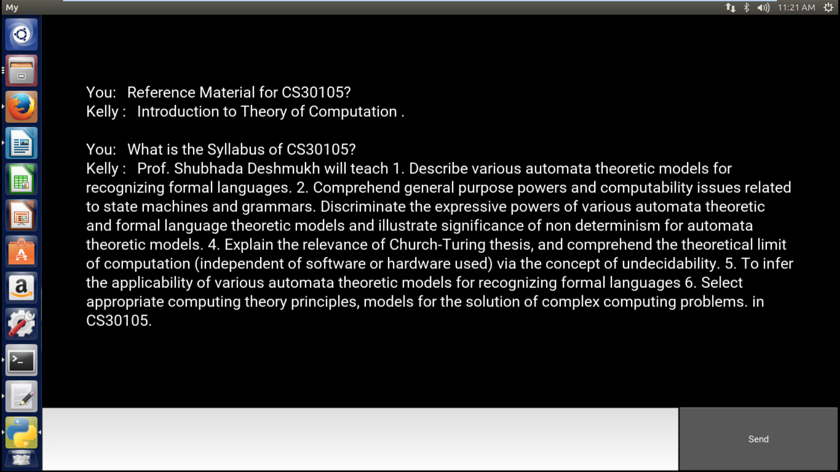
Screenshot

Slide 33
Future Scope
Following improvements are possible:-
Increase the scope of queries, and the Maintenance of a User Accessible Database
Ask user for clarifications on a poorly pattern matched query.
Web crawling for hunting information requested in query in real time.
Natural Language processing part can be improved by incorporating relevant corpus of words tagged with its parts of speech.

Slide 34
References:
Paper:
iAIML based chatterbots for Medical students
Nltk:
https://pythonprogramming.net/

Slide 35
The Team
Karan Parseja
Pracheta Deshpande
Nikita Jituri
Siddhita Joshi
Roll No. 37
Roll No. 20
Roll No. 34
Roll No. 36
Contribution : 25%
Contribution : 25%
Contribution : 25%
Contribution : 25%

Slide 36


